Slide 1

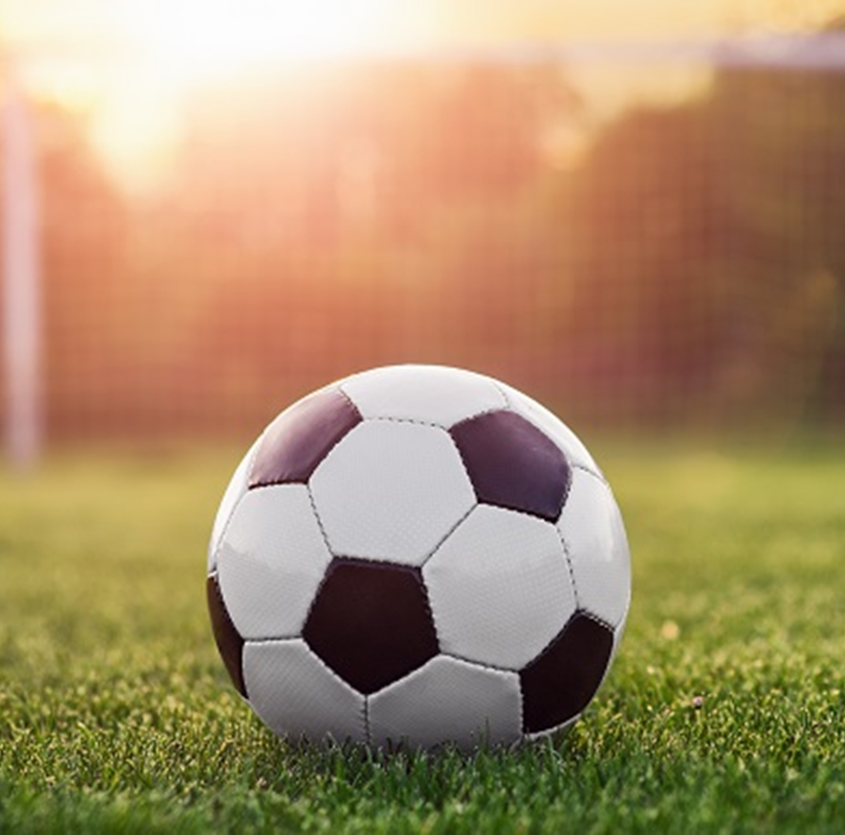
Getting Ready to Play Soccer

Slide 2
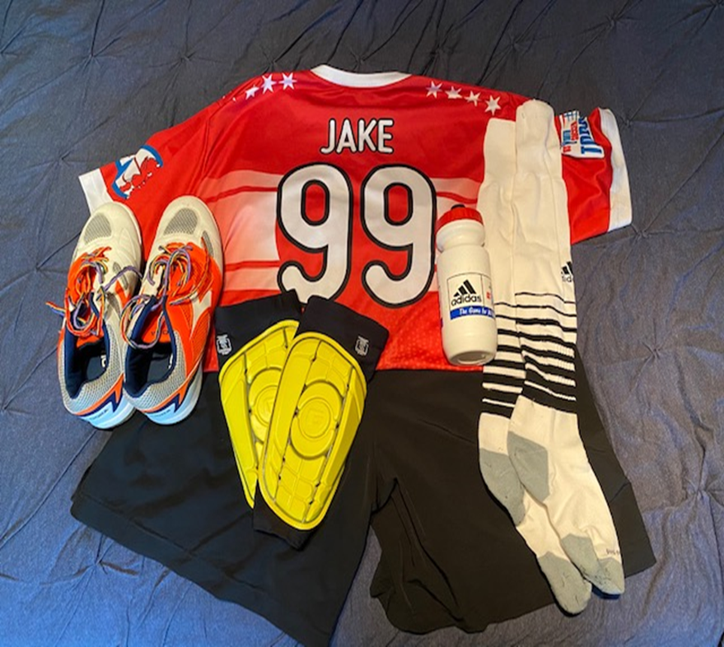
Before I play soccer with my friends, I make sure I have all my equipment ready.
I put together my jersey, shorts, socks, shin guards, shoes, and water bottle.

Slide 3
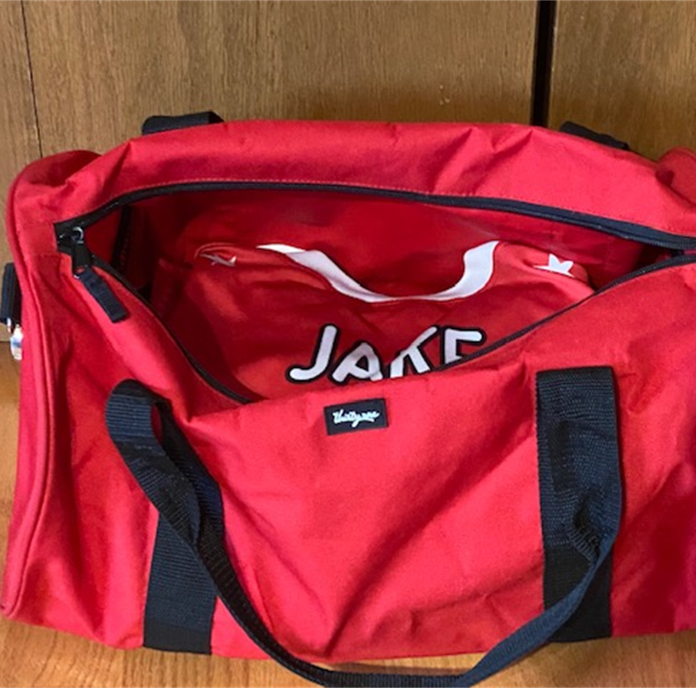
I always keep my equipment in the same place, so everything will be ready.

Slide 4
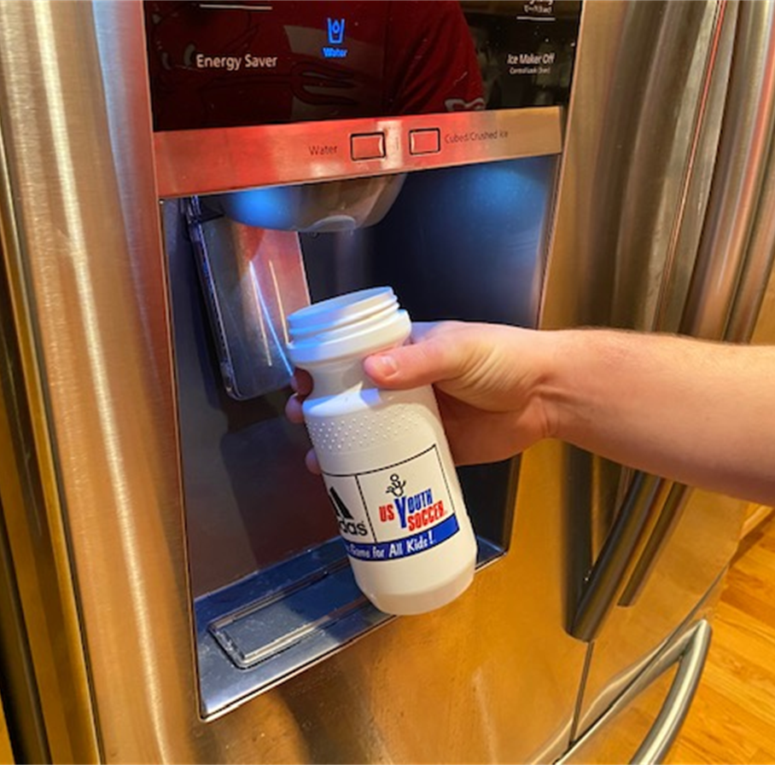
Before I leave home, I make sure to:
put on all my equipment
Fill my water bottle
Go to the bathroom

Slide 5
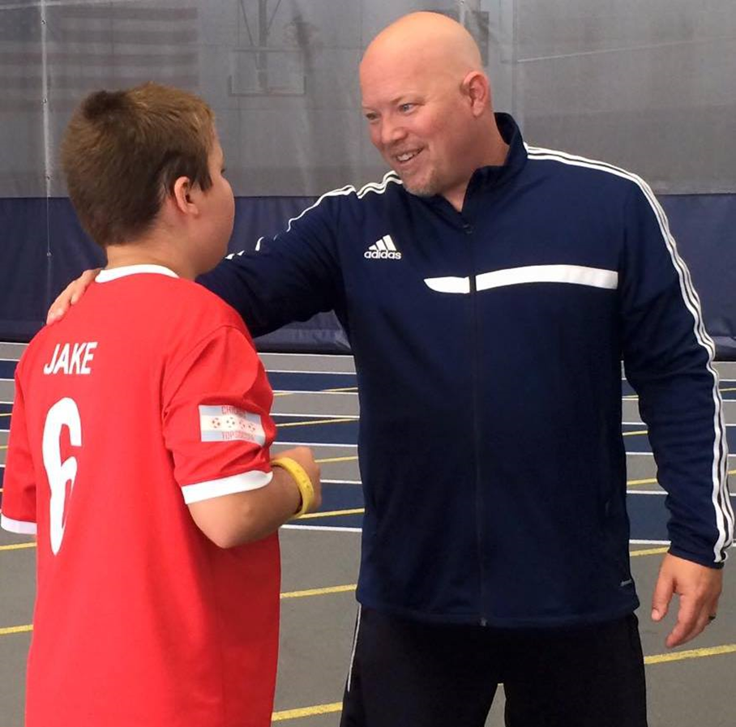
When I arrive at the field, I say hello to my coach and buddy.

Slide 6
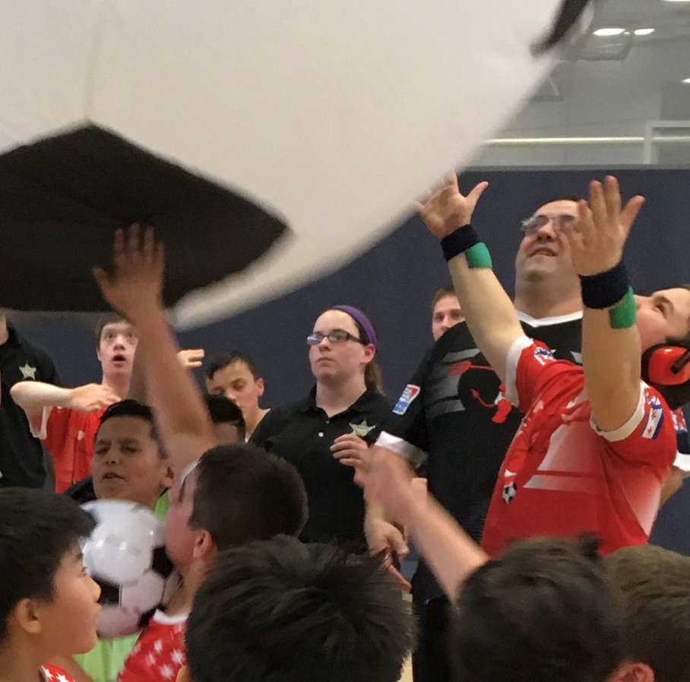
I’m now ready to play soccer with my friends.

