Slide 1

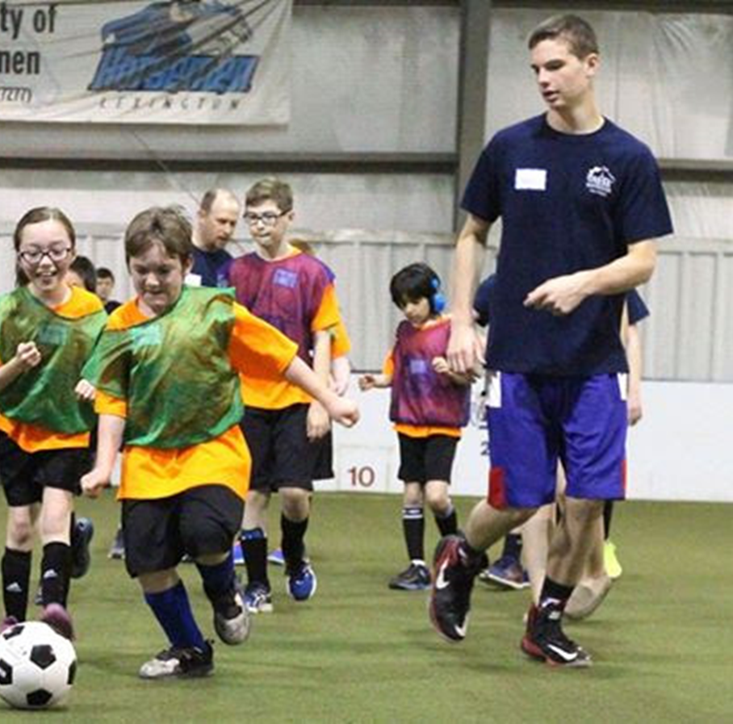
Playing in a Soccer Game

Slide 2
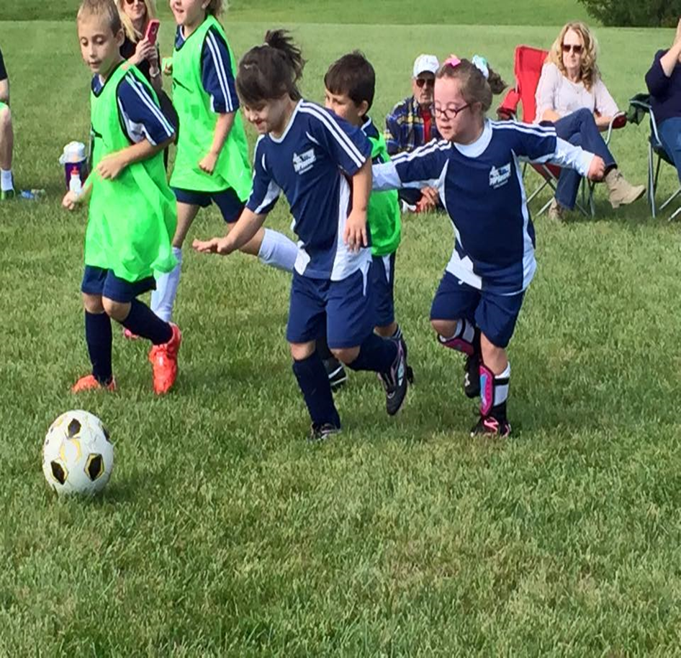
When I play in a soccer game, I try my best to help my team win the game.

Slide 3
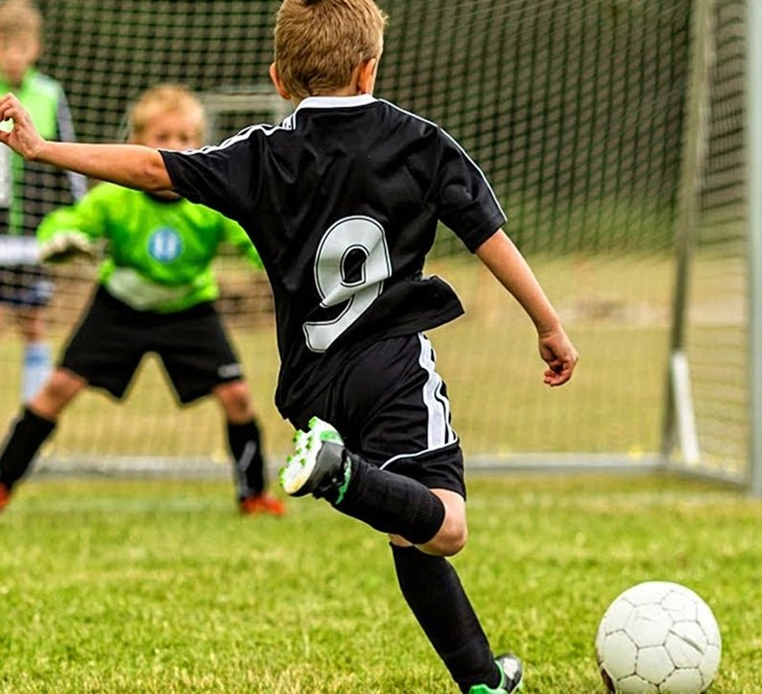
When my team has the ball, we try to score a goal by kicking the ball into the other team’s goal.

Slide 4
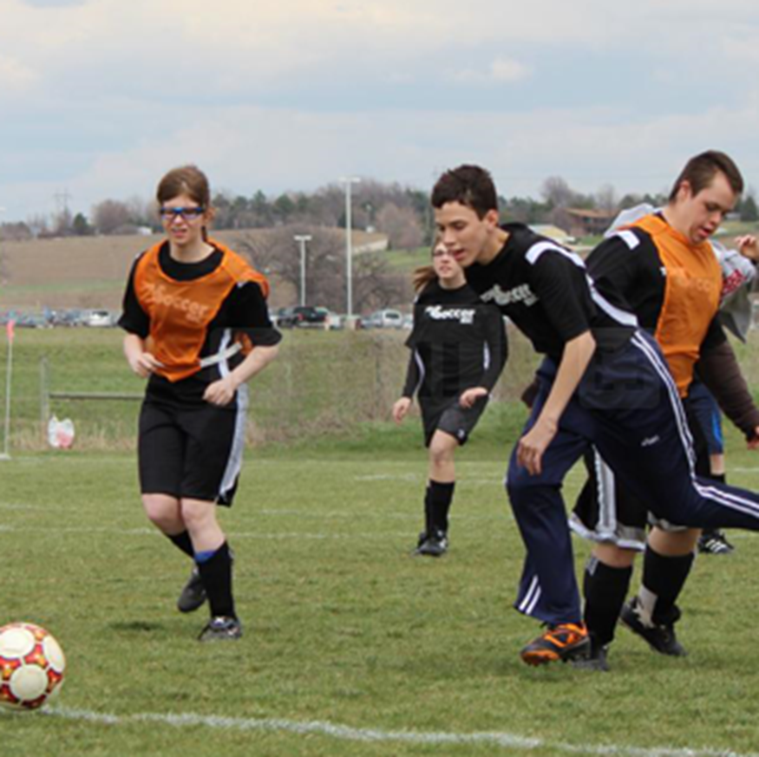
When my team does not have the ball, I try to stop them by taking the ball away from them.
It’s OK to take the ball away from the other team.

Slide 5
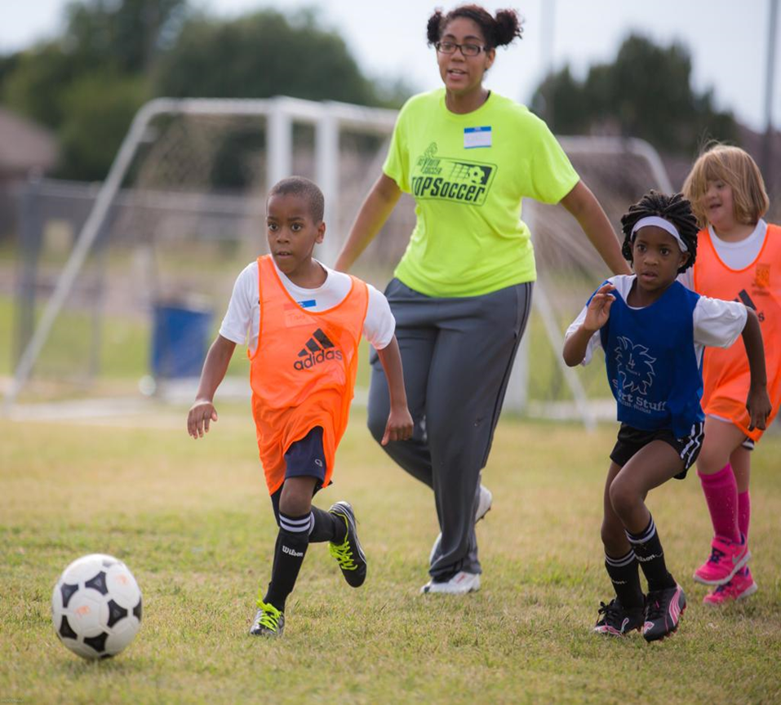
When I have the ball at my feet, I first use my feet to move the ball close to the other team’s goal, and then, kick the ball into the goal

Slide 6
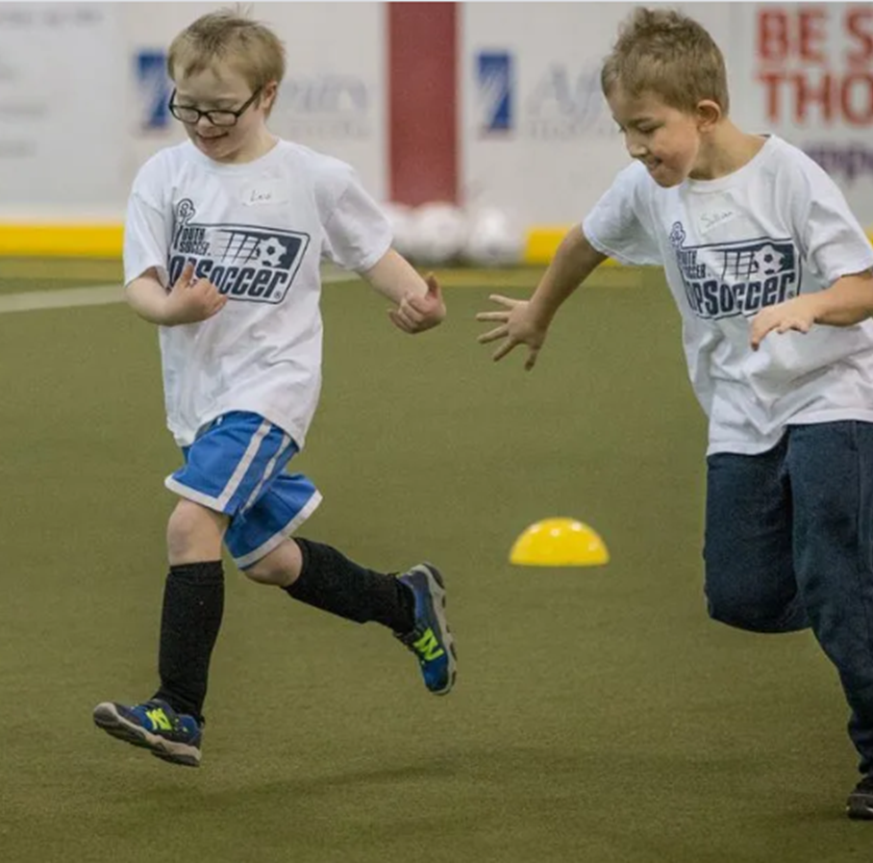
When my teammate has the ball, I don’t try to take it away from them.
I try to get into an open space so that they can pass me the ball

Slide 7
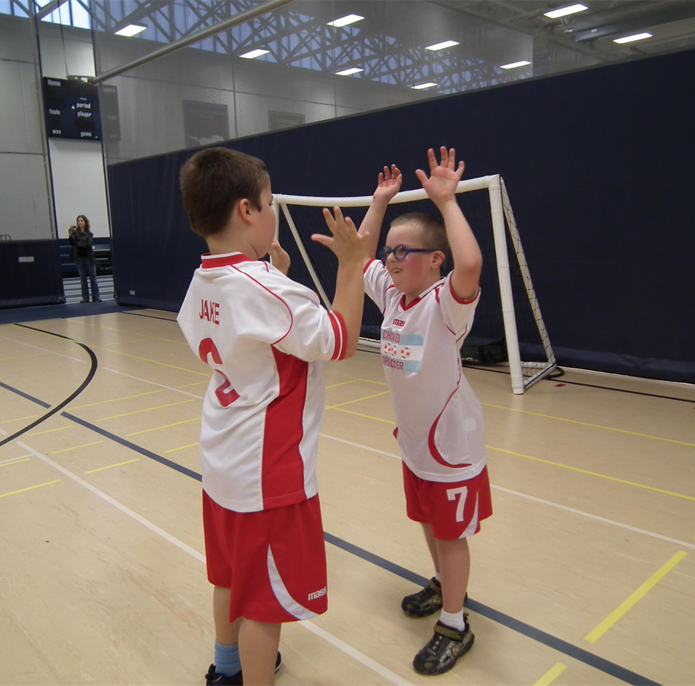
If my team scores a goal, we celebrate together.

Slide 8
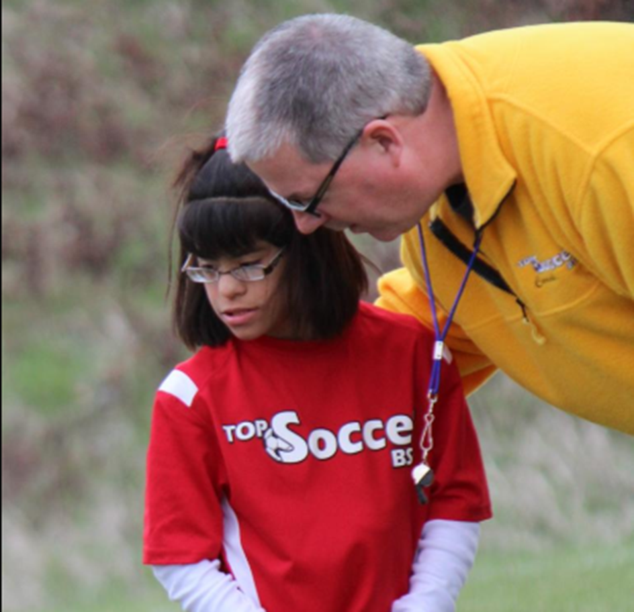
If the other team scores a goal, it’s OK.
We will try to score the next goal.

Slide 9
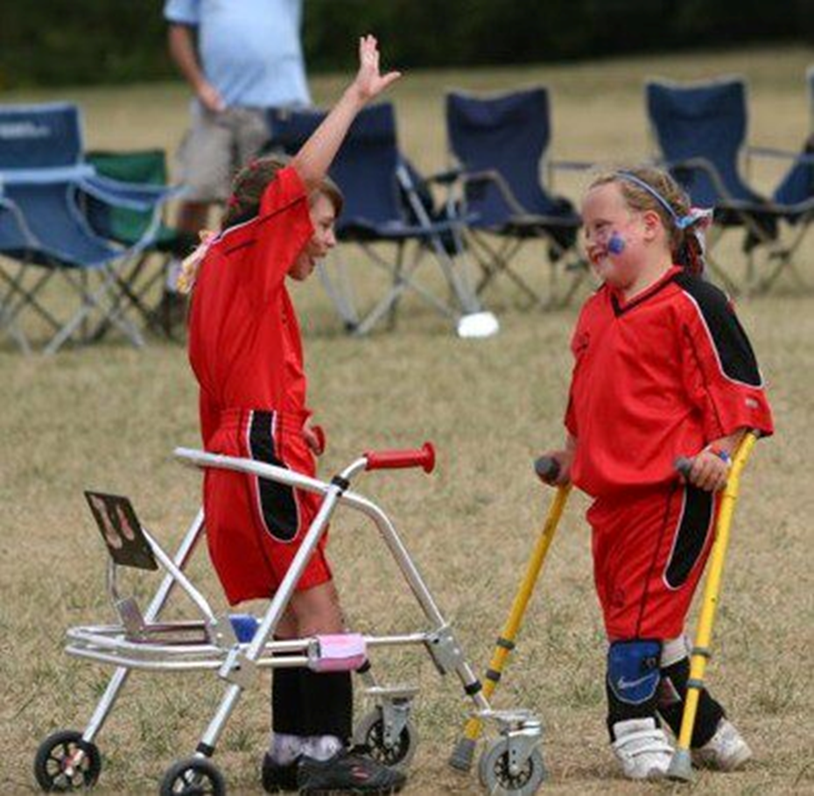
When the game ends, we are happy because we had fun playing soccer with our friends.

