Slide 1

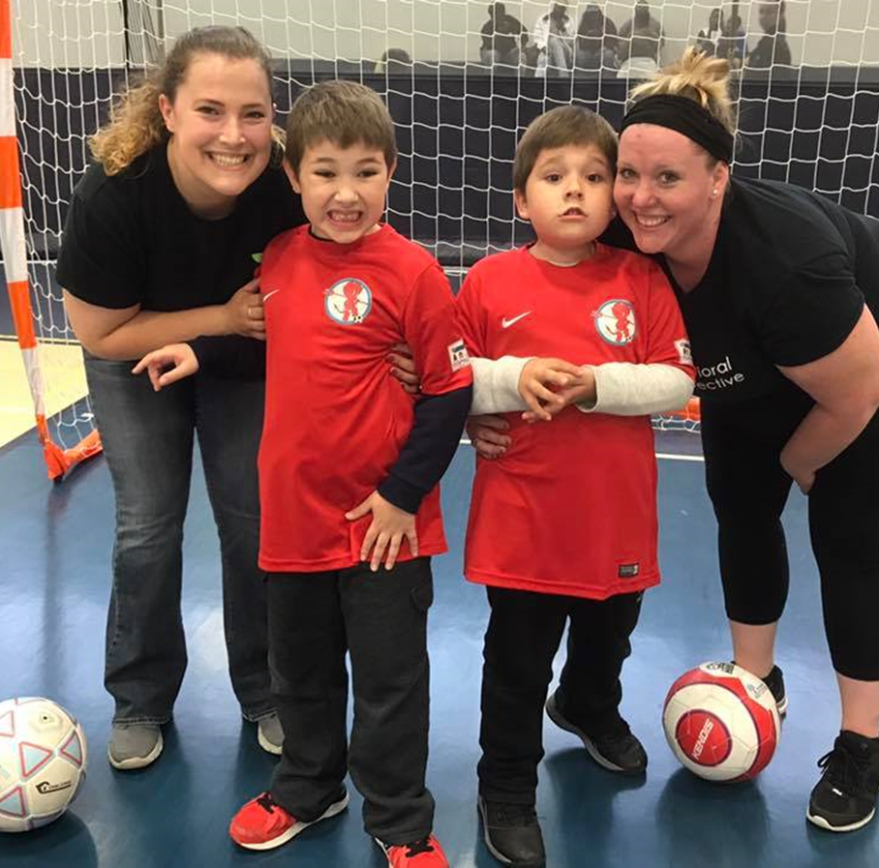
Working with my buddy

Slide 2
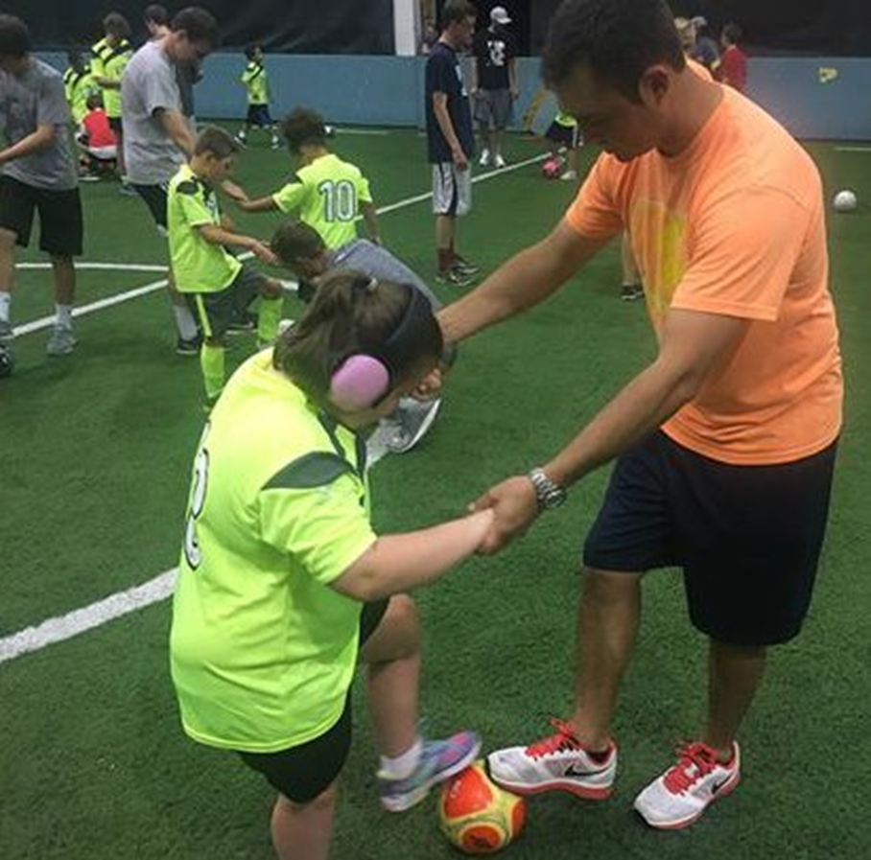
I play soccer with my buddy

Slide 3
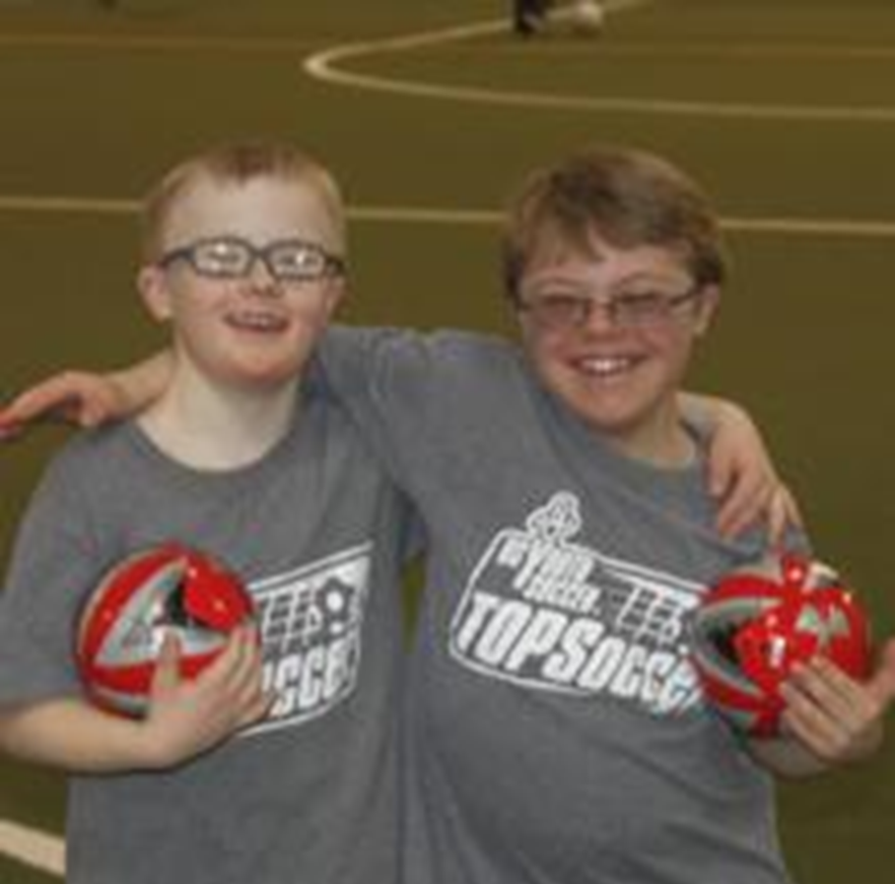
My buddy is there to help me learn about soccer and friendship

Slide 4
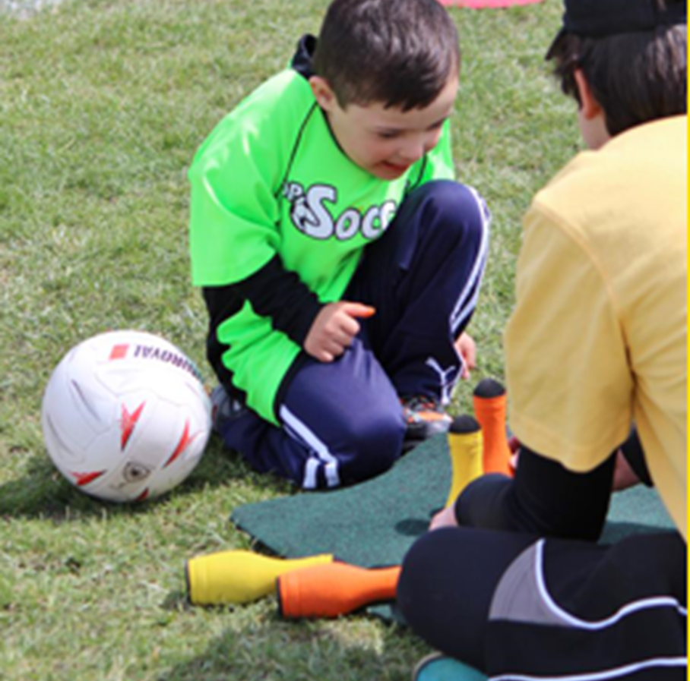
My buddy lets me try to do things for myself but will always help me if I need it.

Slide 5
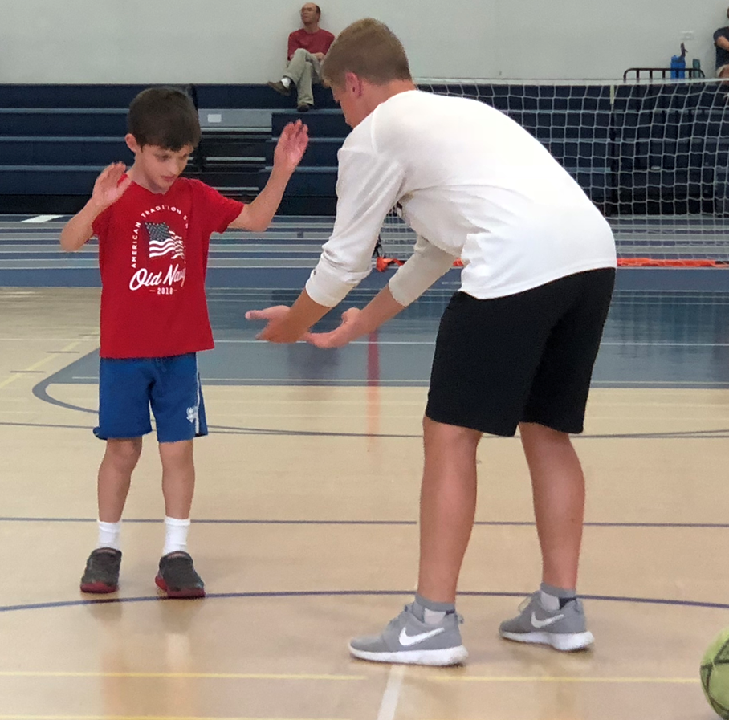
When I do well, we celebrate in my favorite way.

Slide 6
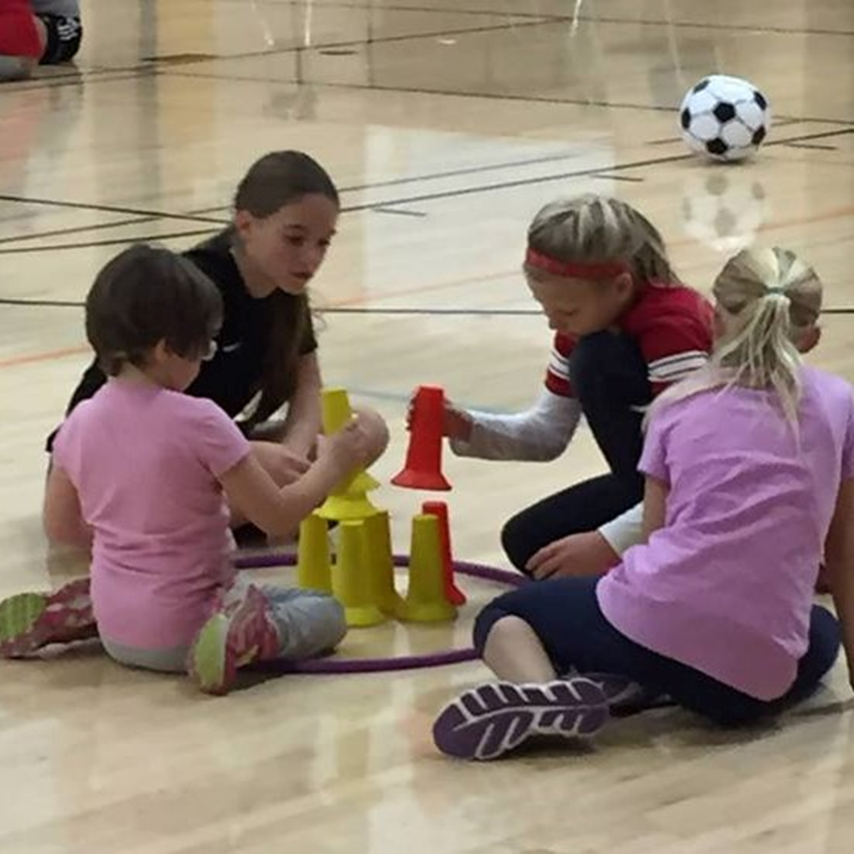
If I want to do something else, my buddy will understand and still play with me

Slide 7
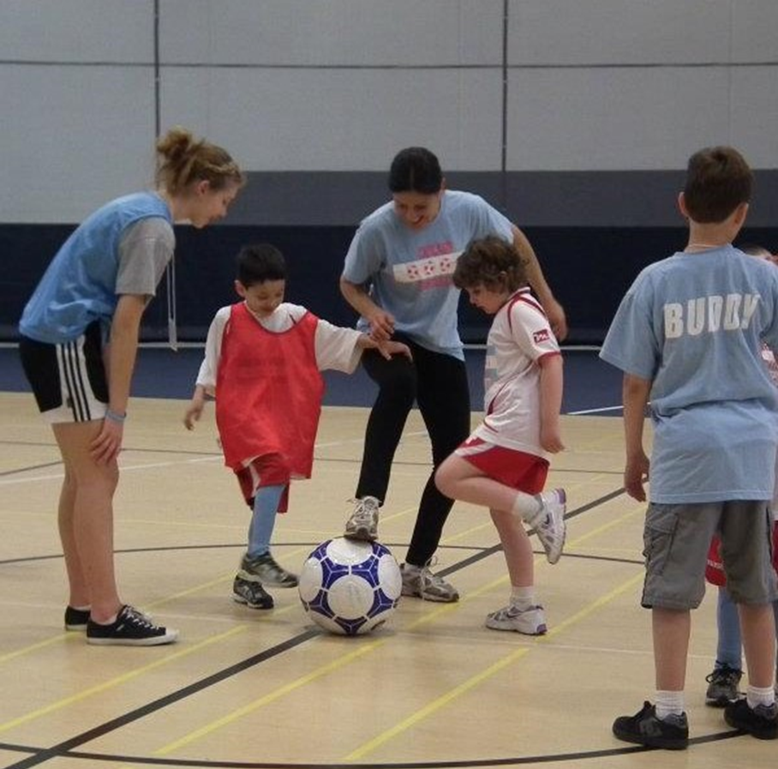
When I play in a soccer game, my buddy helps me and cheers for me

Slide 8
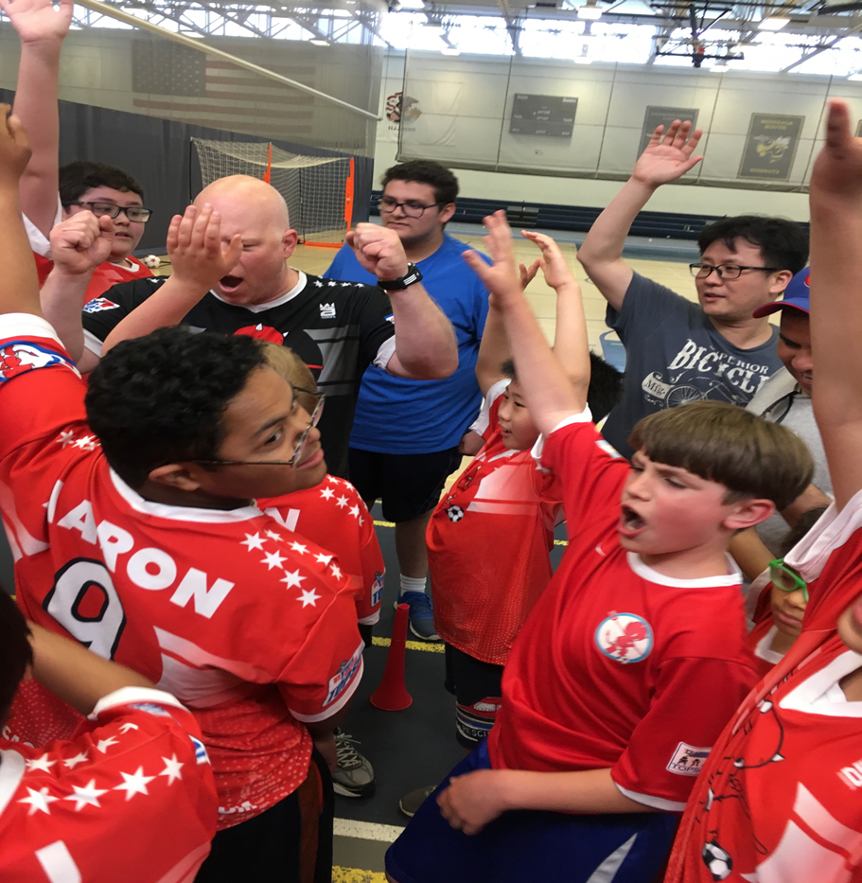
When soccer is over, I say good-bye to my buddy until the next time we play soccer again.

