Slide 1

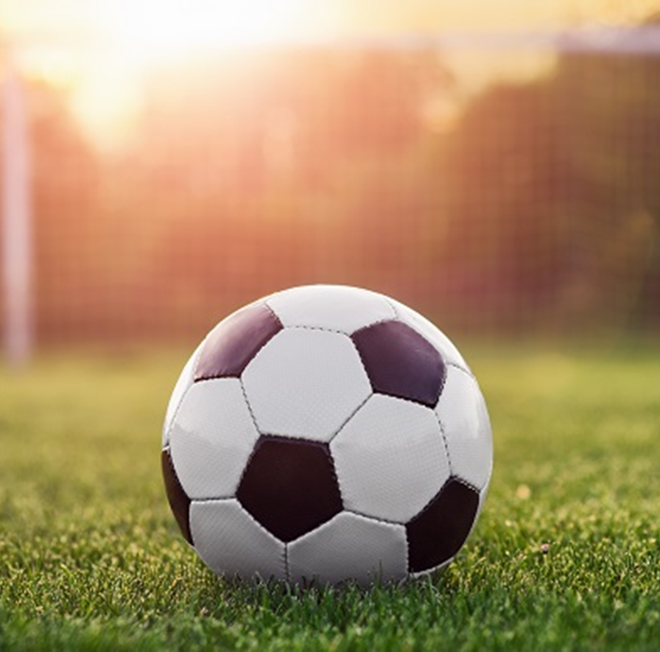
Going to Soccer Practice

Slide 2
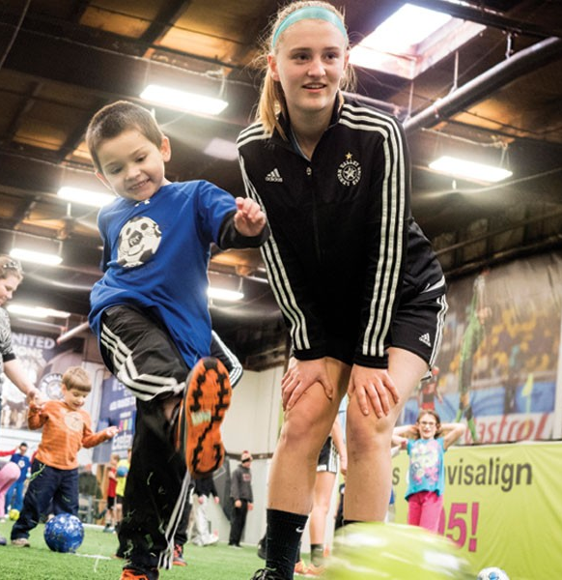
I go to practice to learn new soccer skills, and improve old skills

Slide 3
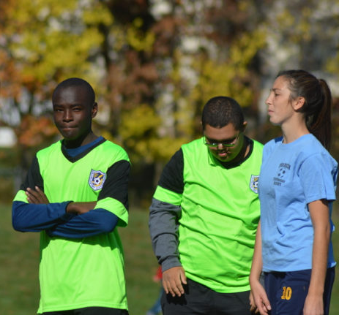
When practice starts, I am quiet, and I listen to the Coach

Slide 4
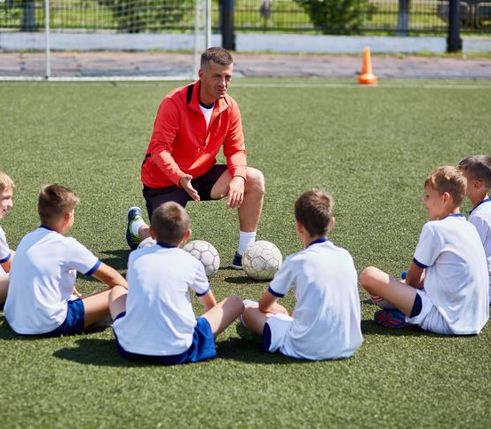
The Coach will tell me what to do.

Slide 5
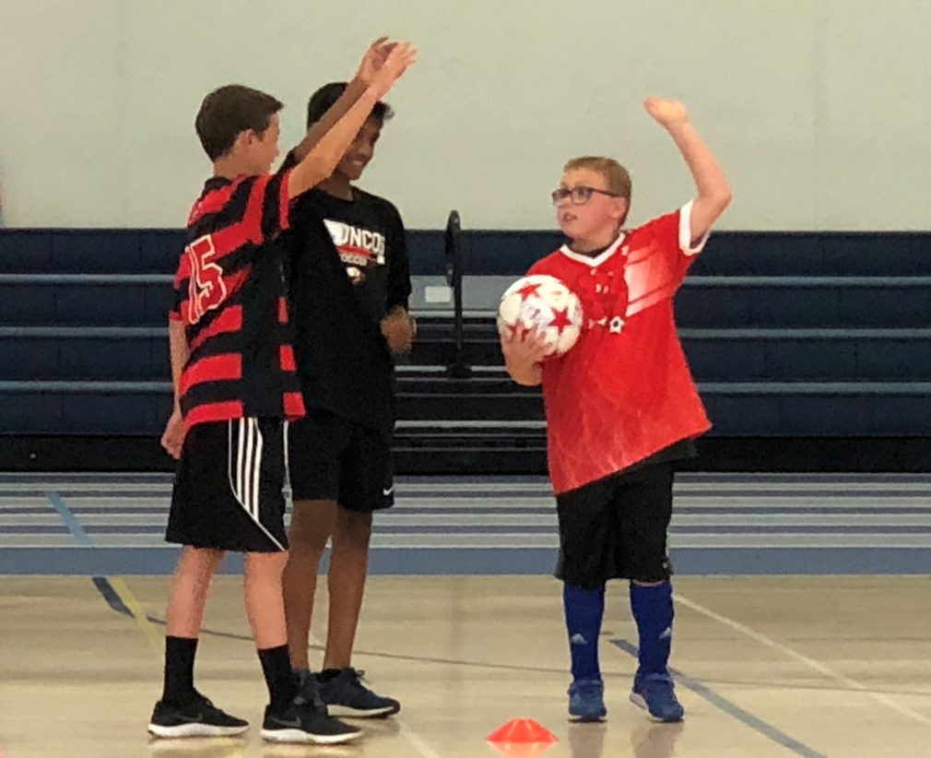
My buddy will help me to learn.

Slide 6
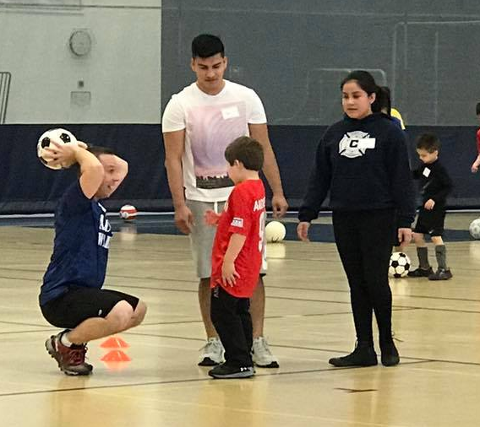
I will try my best and learn with my buddy.

Slide 7
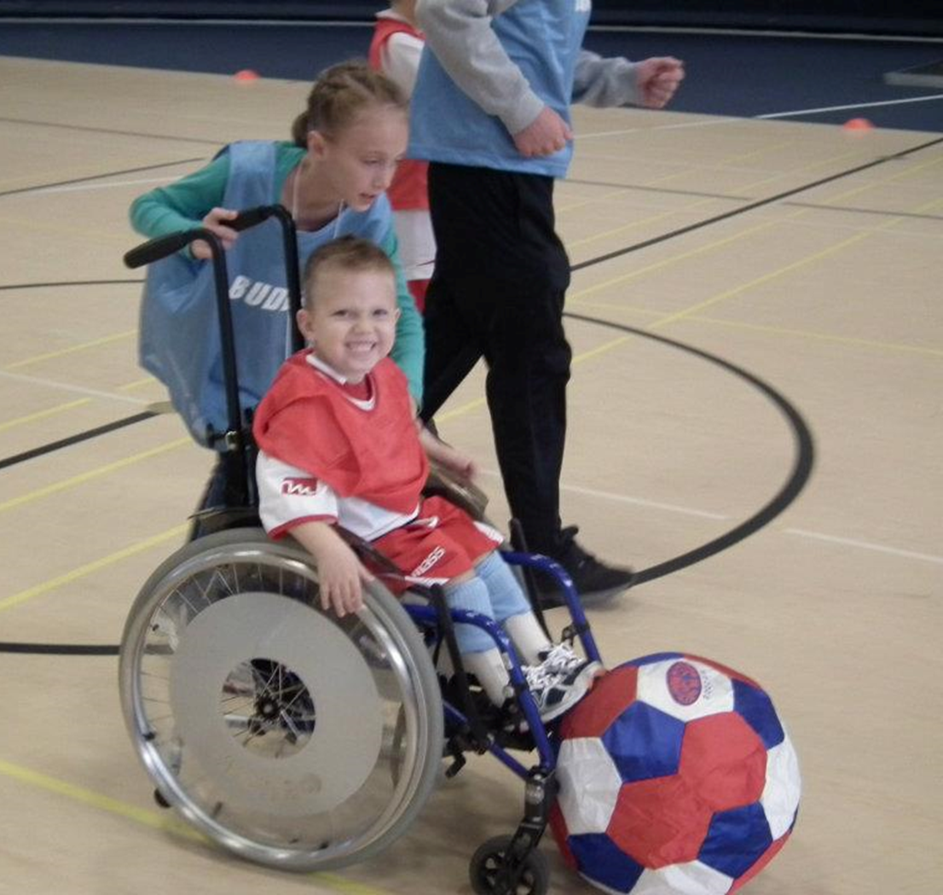
Learning and playing is fun.

Slide 8
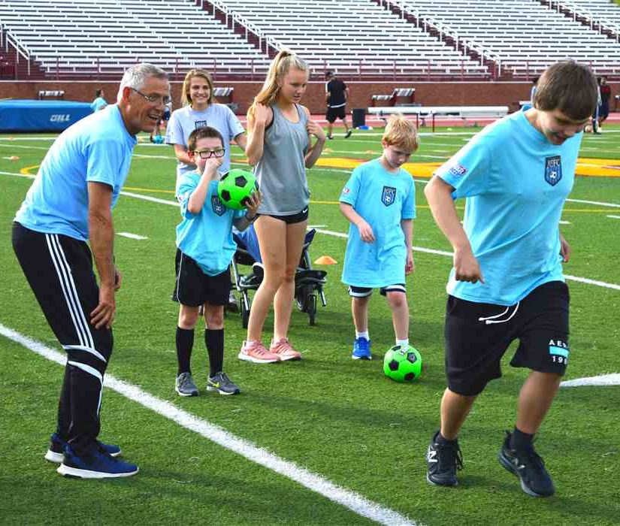
When one exercise is over, Coach will give us a new exercise to try.

Slide 9
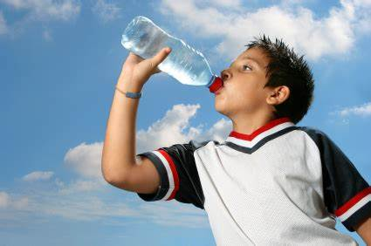
If I am tired or thirsty, I can take a break

Slide 10
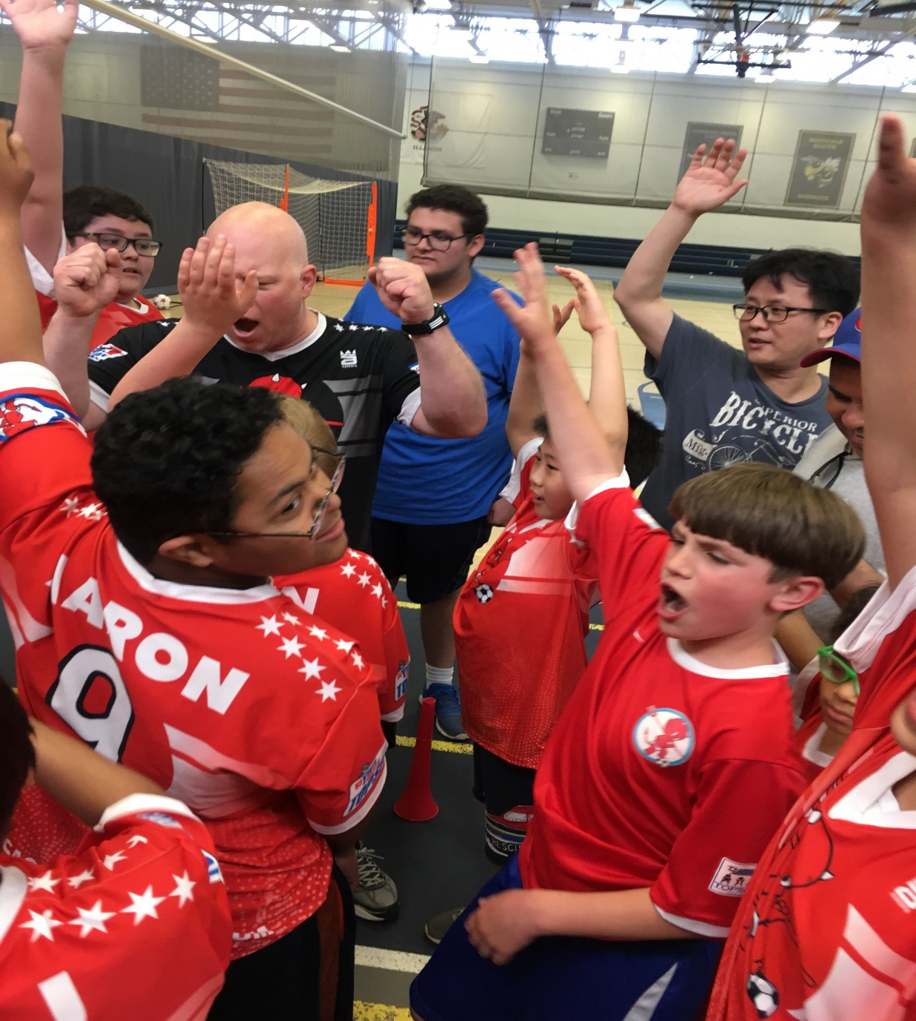
When practice is over, we say goodbye until next time

